Slide 1
Renfeng Wang
Quizzes answers
1. A
2. A

Slide 2
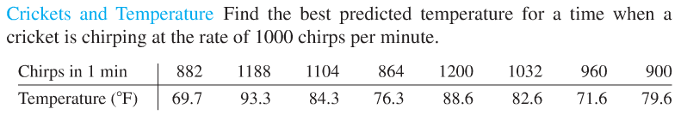
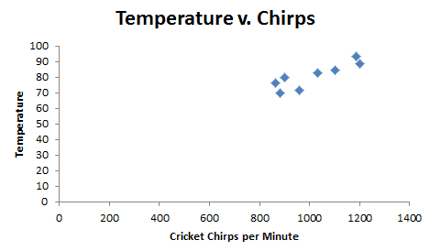
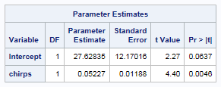
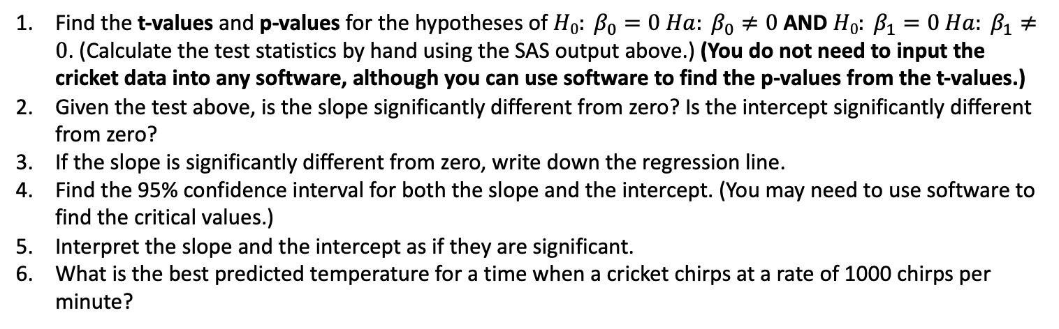
Crickets!!!
Find the t-values and p-values for the hypotheses of $H0: β_{0}=0{ Ha: β}_{0}≠0$ AND $H0: β_{1}=0{ Ha: β}_{1}≠0$. (Calculate the test statistics by hand using the SAS output above.) (You do not need to input the cricket data into any software, although you can use software to find the p-values from the t-values.)
Given the test above, is the slope significantly different from zero? Is the intercept significantly different from zero?
If the slope is significantly different from zero, write down the regression line.
Find the 95% confidence interval for both the slope and the intercept. (You may need to use software to find the critical values.)
Interpret the slope and the intercept as if they are significant.
What is the best predicted temperature for a time when a cricket chirps at a rate of 1000 chirps per minute?

Slide 3


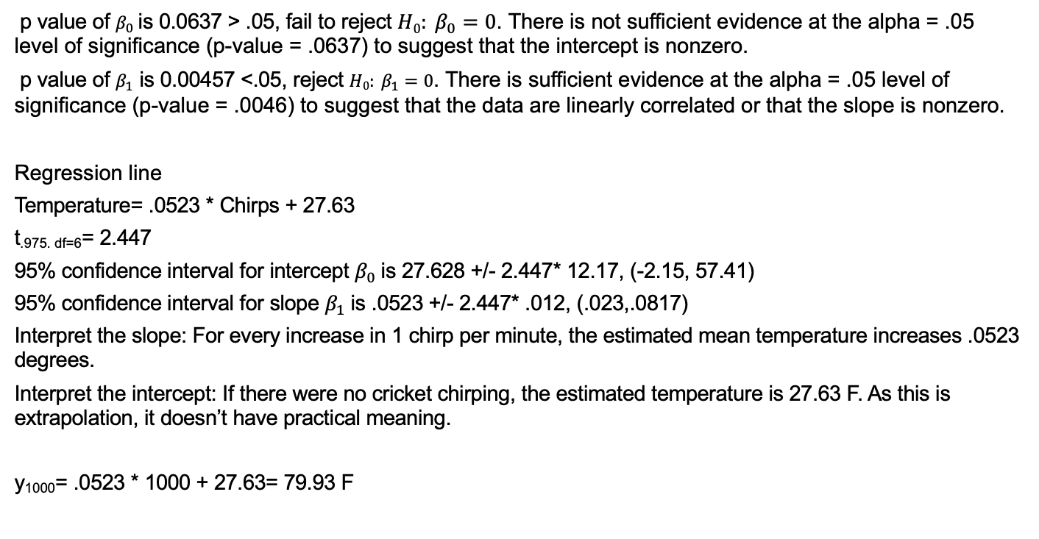
t value of $β_{0}$ is 27.63/12.17 = 2.27, p value is 0.0637
t value of $β_{1}$ is .05227/.01188= 4.40, p value is 0.00457
p value of $β_{0}$is 0.0637 > .05, fail to reject $H0: β_{0}=0$. There is not sufficient evidence at the alpha = .05 level of significance (p-value = .0637) to suggest that the intercept is nonzero.
p value of $β_{1}$ is 0.00457 <.05, reject $H0: β_{1}=0$. There is sufficient evidence at the alpha = .05 level of significance (p-value = .0046) to suggest that the data are linearly correlated or that the slope is nonzero.
Regression line
Temperature= .0523 * Chirps + 27.63
t_{.975. df=6}= 2.447
95% confidence interval for intercept $β_{0}$is 27.628 +/- 2.447* 12.17, (-2.15, 57.41)
95% confidence interval for slope $β_{1}$is .0523 +/- 2.447* .012, (.023,.0817)
Interpret the slope: For every increase in 1 chirp per minute, the estimated mean temperature increases .0523 degrees.
Interpret the intercept: If there were no cricket chirping, the estimated temperature is 27.63 F. As this is extrapolation, it doesn’t have practical meaning.
y₁₀₀₀= .0523 * 1000 + 27.63= 79.93 F

Slide 4
Renfeng Wang
Take away
1. Learned to examine the assumptions for linear model
2. Learned to interpret the intercept and slope of the regression line.
3. Learned to calculate the slope, intercept and t value by hand.
Questions
Video 9.5, I’m confused on children’s height example and three groups skill level example.

